Slide 1
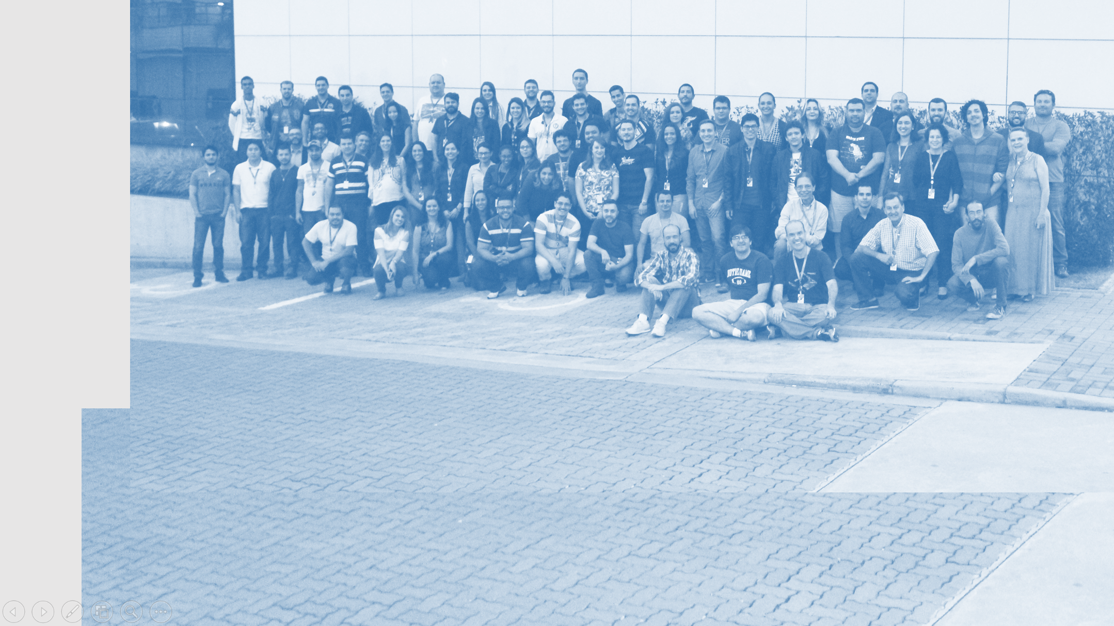
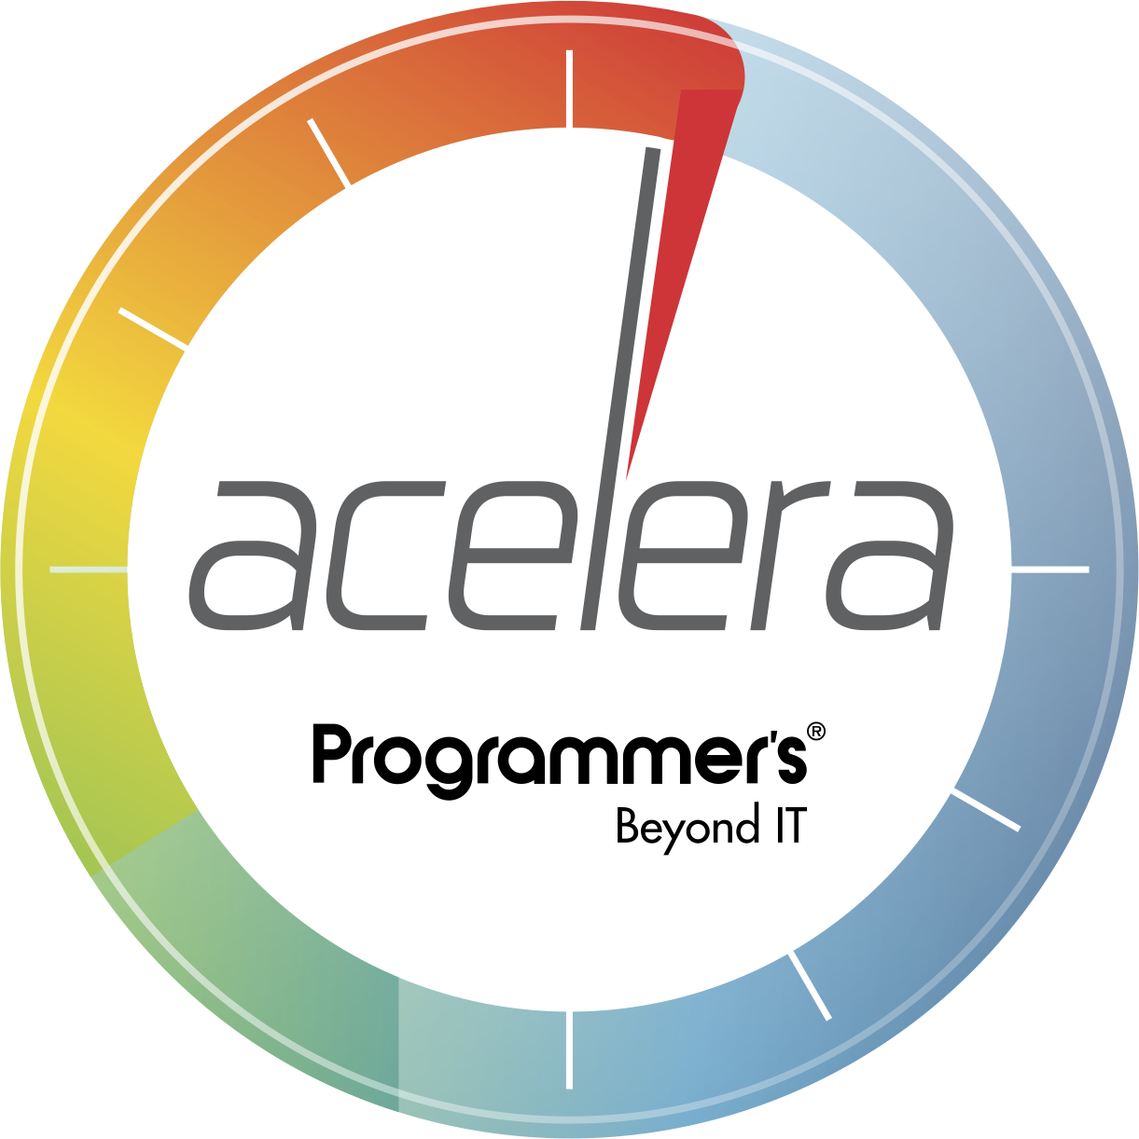

Automatização de testes em APIs utilizando Postman

Slide 2

Workspaces
Mock Server + APIs
API Requests
GET
POST
PUT
PATCH
DELETE
Collections + Tests
Test Runs
Newman + Docker
Jenkins Integration

Slide 3


